Slide 1
A Power Auction Approach For Non-Orthogonal Multiple Access Wireless Relay Communications.
Krishna Murthy Kattiyan Ramamoorthy, San Diego State University, USA
Dr. Wei Wang, San Diego State University, USA
Dr. Kazem Sohraby, Utah Valley University, USA
This research was supported in part by National Science Foundation Grants No. 2010284 and No. 2010012

Slide 2
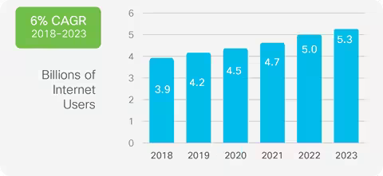
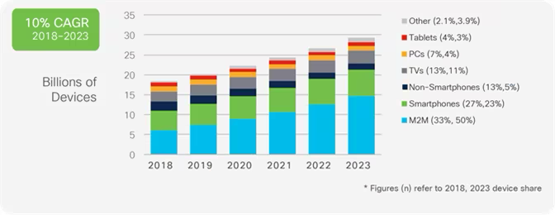
Introduction : Bandwidth at Risk
As of 2022, the estimated number of internet users worldwide was 5.3 billion, up from 4.9 billion in the previous year. This share represents 66 percent of global population.
Each internet user also has several internet ready-devices.
Therefore, the existing wireless communication architecture is struggling to meet the demands of the everyday user.
Ref: Cisco Visual Networking Index: Forecast and Trends White Paper

Slide 3
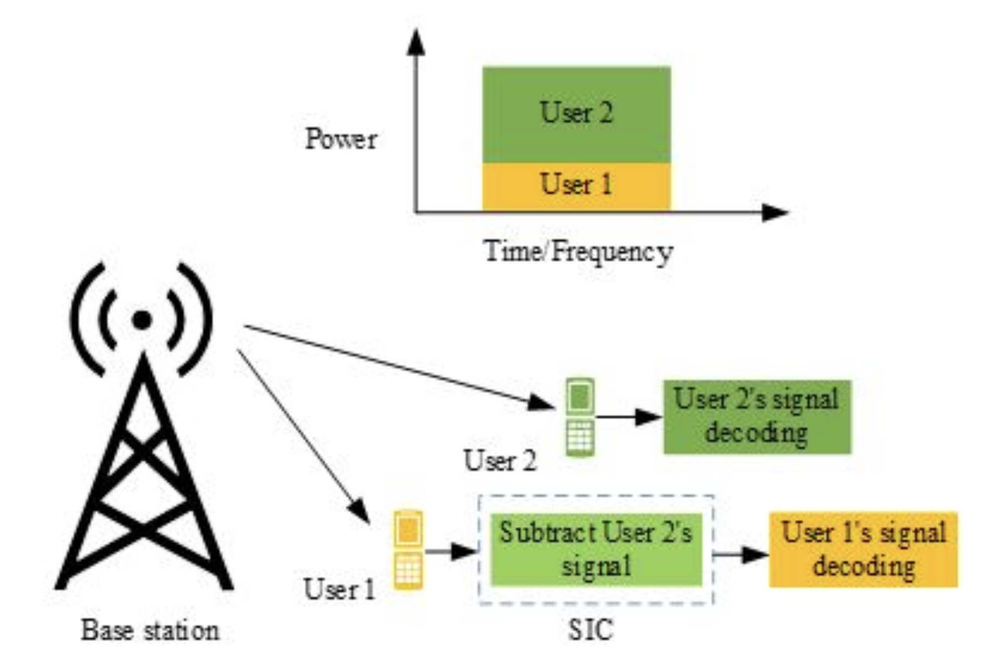
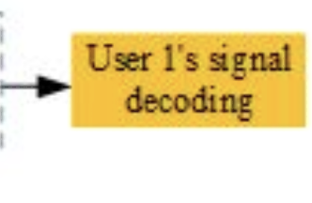
Orthogonal Multiple Access
This modern-day network access scheme is called Orthogonal on Multiple access (OMA).
In OMA, the base station is able to support exactly one user during a time/frequency slot.
This ensures that the user’s signals do not interfere with one another.
However, this limits the total number of users a base station can support and introduces latency as the number of users in a network increase.
Ref: Islam, S.M., Zeng, M. and Dobre, O.A., 2017. NOMA in 5G systems: Exciting possibilities for enhancing spectral

Slide 4
Non-Orthogonal Multiple Access
Non-orthogonal Multiple Access (NOMA) has a potential to decrease latency & improve spectral efficiency in future wireless networks.
The base stations uses Superposition Coding (SC) to generate a superimposed signal of all users to be transmitted simultaneously.
The user would employ Successive Interference Cancellation (SIC) to decode their data from the overlaying signal.
Ref: Islam, S.M., Zeng, M. and Dobre, O.A., 2017. NOMA in 5G systems: Exciting possibilities for enhancing spectral

Slide 5
NOMA Drawback
$${\left|h_{1}\right|}^{2}$$
No Interference
U1
$${\left|h_{2}\right|}^{2}$$
Base Station
Interference from U1
U2
$${\left|h_{3}\right|}^{2}$$
Interference from U1 and U2
U3
$${\left|h_{4}\right|}^{2}$$
Channel gain:
U4
Interference from U1, U2 and U3
As the number of users in a NOMA block increase, the users with worser channel gain experience higher levels of interference.

Slide 6
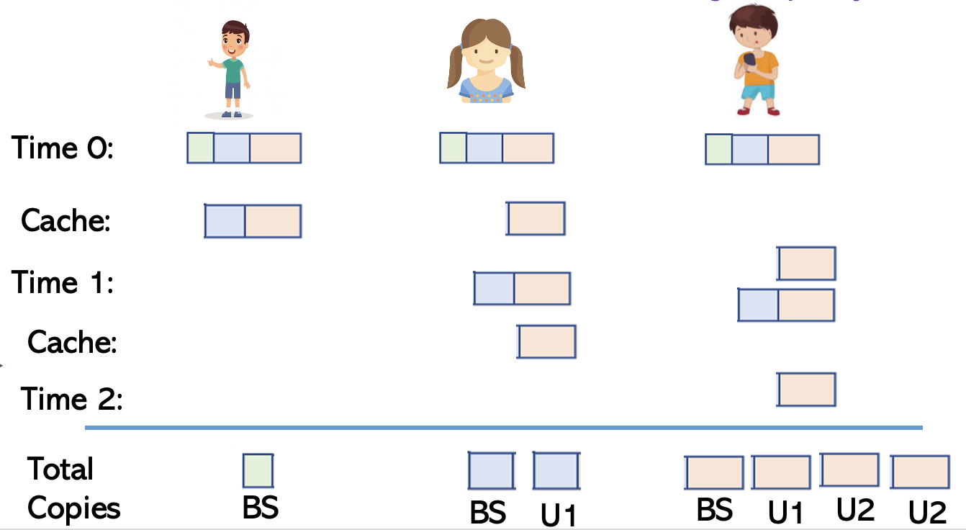
D2D Relay Enabled In NOMA
U1
U2
U3
D2D or Device-to-Device communication has a potential to improve throughput, power efficiency, delay, and fairness of all EUs in the network.
The shortcoming of NOMA can easily be negated by enabling D2D communication in a NOMA Network.
In a D2D enabled NOMA, the users with higher channel gain can cache and forward the packets to users with weaker channel gain to improve their overall SINR.

Slide 7
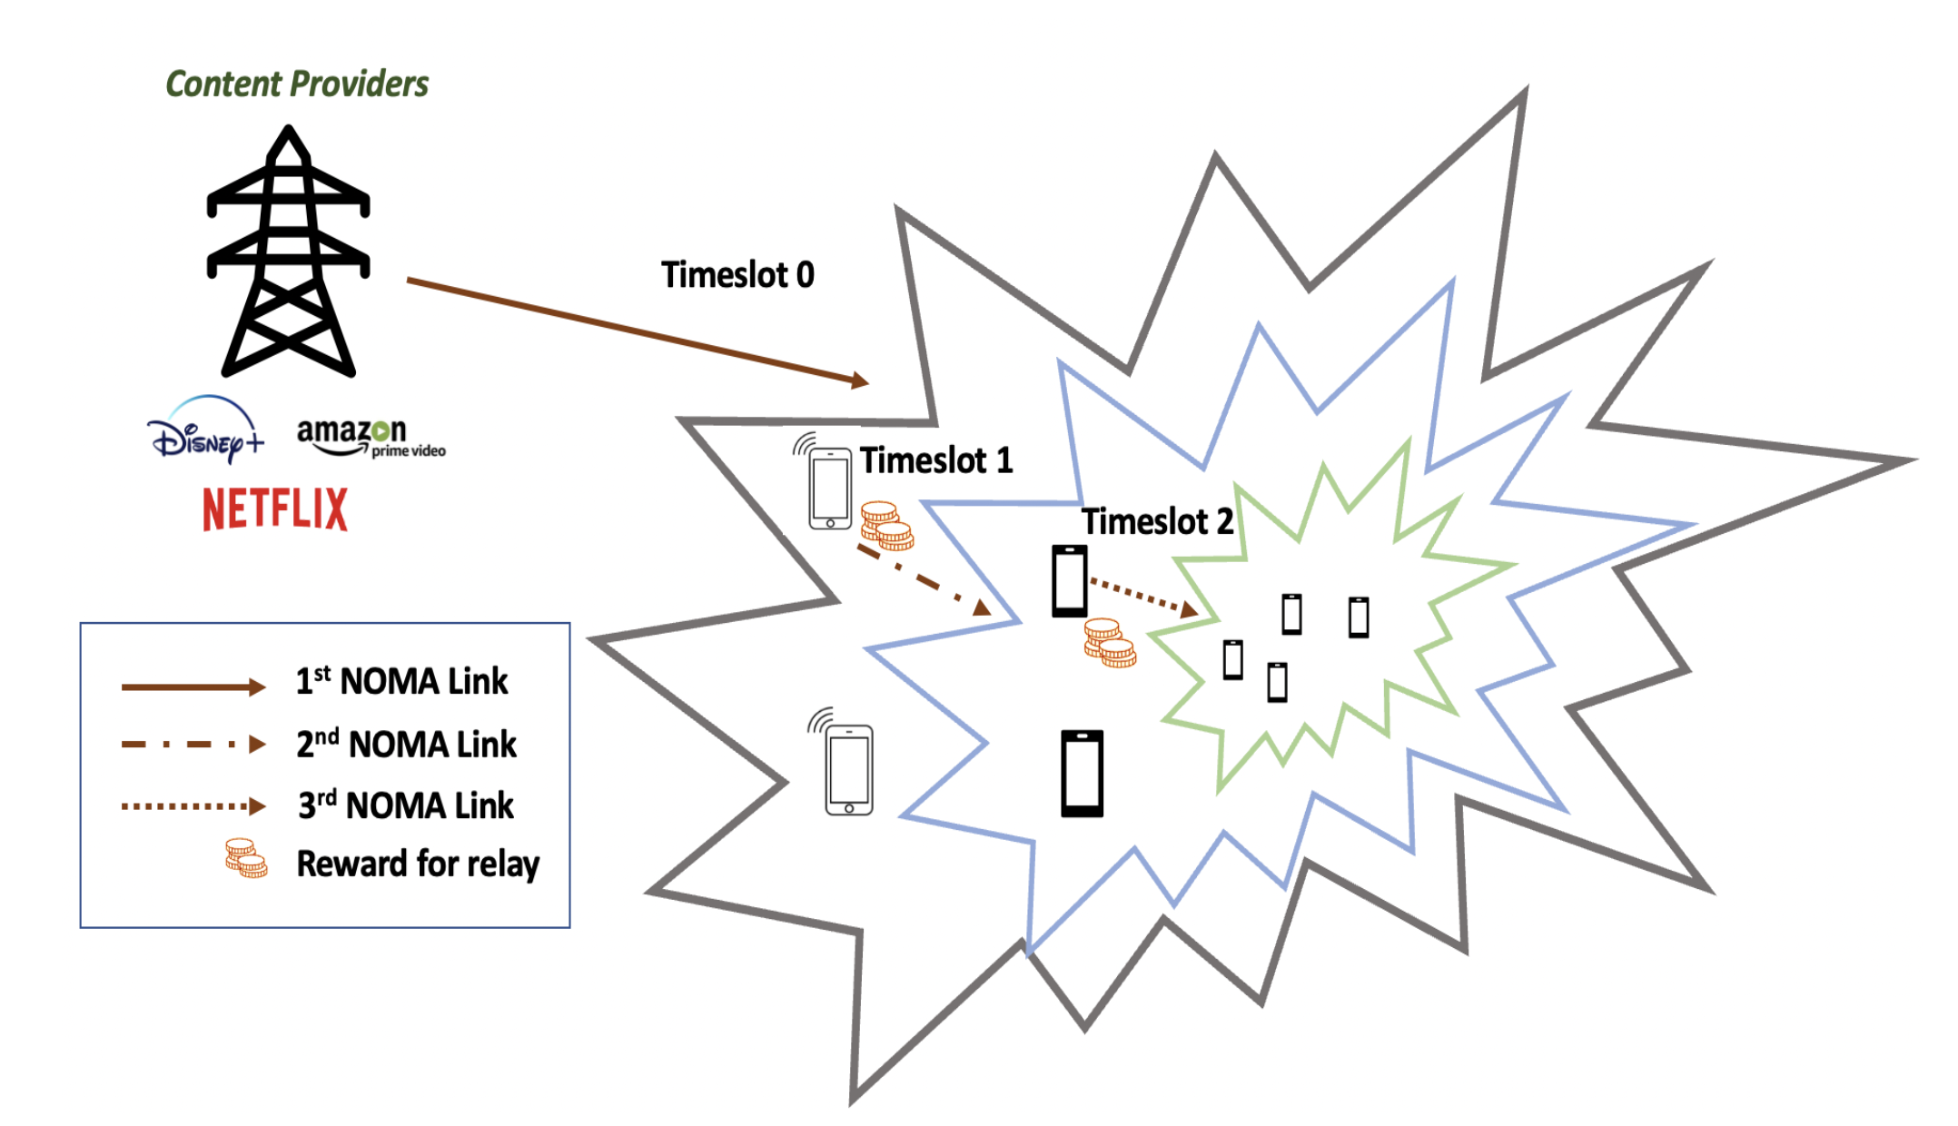
Envisioned D2D Enabled NOMA Network
For the stronger channel gain users to cache and forward the information – a suitable incentive needs to be provided.
In this work, we propose solutions from Auction theory to find the optimal price for the retransmitted data.

Slide 8
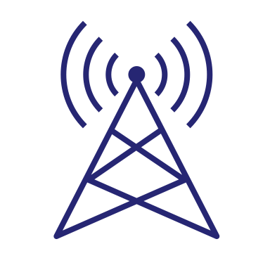
QoE Modelling
Let ${|h_{i}|}^{2}$ denote the channel gain of ${UE}_{i}$. Without loss of generality, we assume that the UEs are ordered based on their channel gain:
The SINR for EU1 can be represented as
Time 1
$$BS$$
$SINR_{EU_{1}}=\frac{P_{1}{\left|h_{1}\right|}^{2}}{σ^{2}}$
$$EU_{1}$$
The SINR for EU2 can be represented as
Time 0
$SINR_{EU_{2}}=\frac{P_{2}{\left|h_{2}\right|}^{2}}{P_{1}{\left|h_{2}\right|}^{2}+ σ^{2}}$
$$EU_{2}$$
Interference from EU1
The user EU2 also receives another copy of the information from EU1 during the next timeslot
Power allocated by EU1 for EU2
$SINR_{EU_{2}}=\frac{P_{2}{\left|h_{2}\right|}^{2}}{P_{1}{\left|h_{2}\right|}^{2}+ σ^{2}}+\frac{P_{1,2}{\left|h_{1,2}\right|}^{2}}{σ^{2}}$
Channel b/w EU1 and EU2
SINR Gain D2D communication

Slide 9
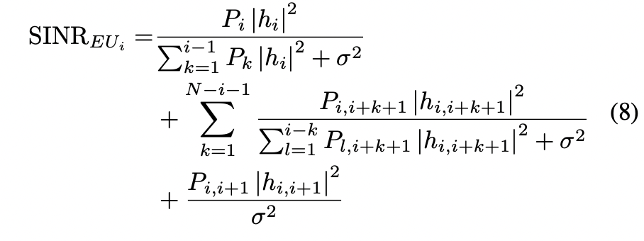
QoE Modelling
Assuming that all the EUs cache and retransmit the data to weaker users. The Generalized SINR gain for a user $EU_{i}$ can be expressed as
SINR Gain from BS transmission (time 0)
SINR Gain from retransmission $EU_{1}$ to $EU_{i−2}$
SINR Gain from retransmission $EU_{i−1}$
The two-level logarithmic function has been widely adopted in modelling the QoE equations in wireless communications.
$$QoE_{i}=α \log_{2} \left(1+ B \log_{2}\left(1+SINR_{EU_{i}} \right)\right)$$
Data Rate using Shannon Capacity Theorem
Ref: Z. Su, Q. Xu, M. Fei and M. Dong, “Game Theoretic Resource Allocation in Media Cloud with Mobile Social Users”, IEEE Transactions on Multimedia, Vol.18, No. 8, August 2016.

Slide 10
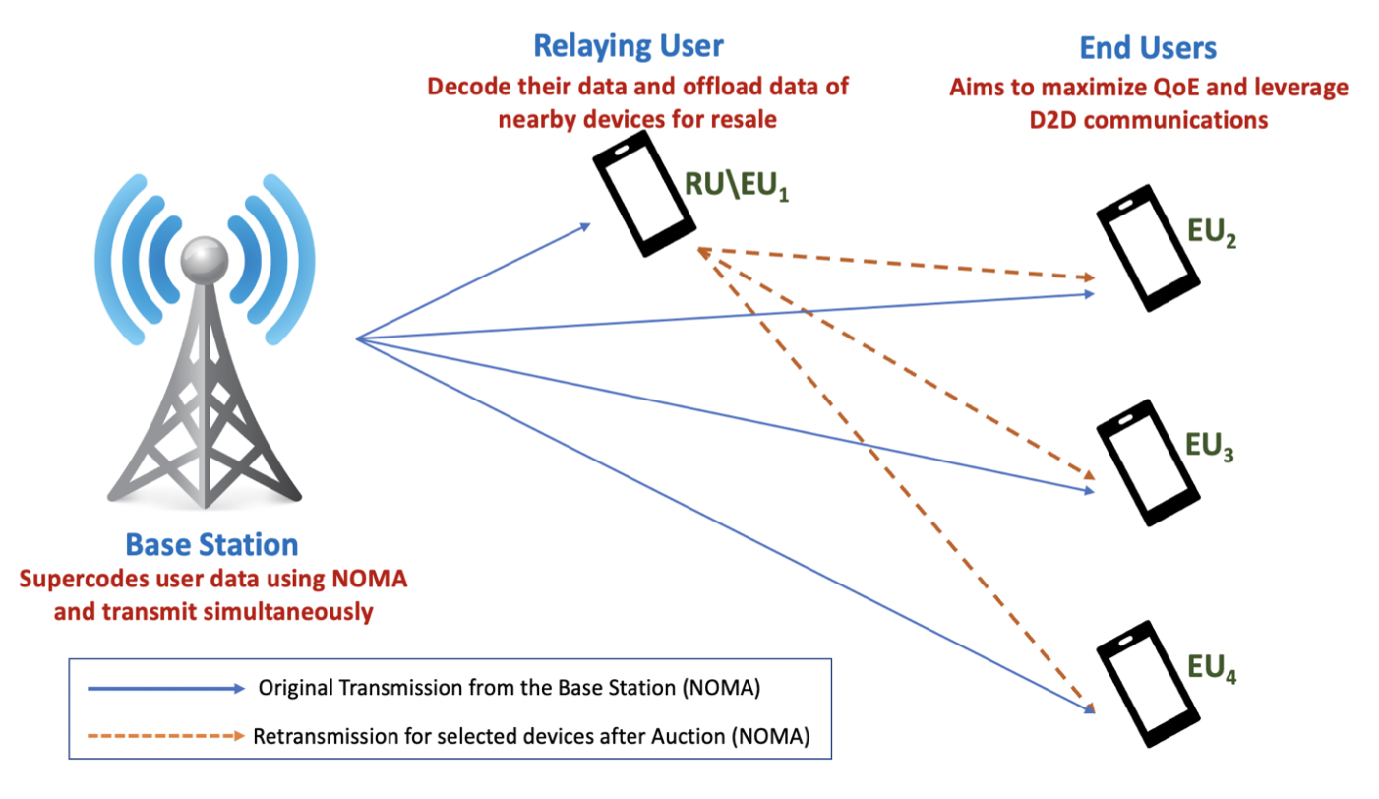
Utility Definitions
To demonstrate the solution, we consider a single round of retransmission. (time-slot 1 and EU1)
Solution is independent of the number of rounds and can be easily extended.
Utility of the user (EU)
Cost for unit power (retransmission)
Power purchased for retransmission
$U_{EU_{i}}=QoE_{i}−y_{i}P_{i}$ $−δ_{i}P_{1,i}$
Interplay b/w BS and EU. Solution derived using Game theory.
(Previous work)
Interplay b/w Relay and EU. Solution derived using Auction theory.

Slide 11
Utility Definitions
Cost of the relay
The transmission cost is determined by the packet length $l$, transmission power $P_{i,m}$, constellation size of modulation scheme $b$ and the bandwidth $B$. $_{m}$is defined as the currency value per unit energy consumption
$${Cost}_{relay}=λ_{m} \frac{lP_{i,m}}{b.B}$$
Utility of the Relay
Utility of the relay would be the money paid by the user for retransmission subtracted by the cost spent in caching the content.

Slide 12
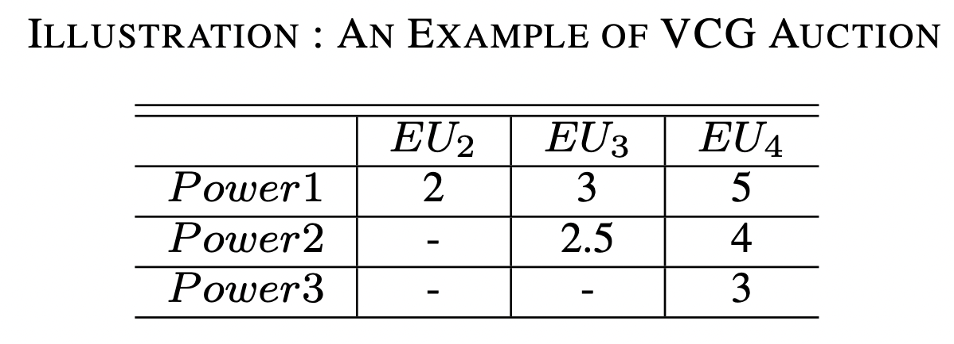
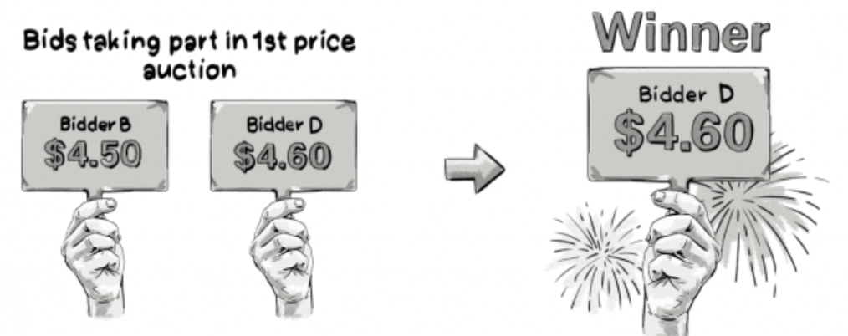
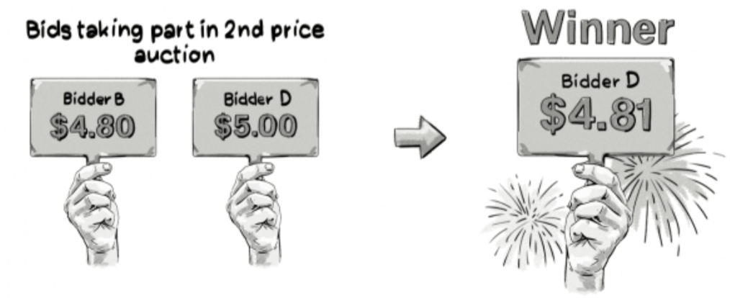
Auction of NOMA Relay
Examples of bids placed for timeslot 1
We consider one round of retransmission – the solution can however be extended multi-level relaying.
First Price Sealed Bid Auction
Second Price Sealed Bid Auction

Slide 13
Second Price Auction is stable (No regrets)
Truth telling is the dominant strategy. Therefore, the user bid their actual valuation.
Imagine you are the loser:
You pay less than your valuation of service
Increase bid?
Still lose and pay nothing
win.. But pay more than you value the service
Decrease bid?
Still lose and receive nothing.
Imagine you are the winner:
You pay less than your valuation of service
Increase bid?
Still win and pay second price
Decrease bid?
Still win and pay second price
Lose and pay nothing.

Slide 14
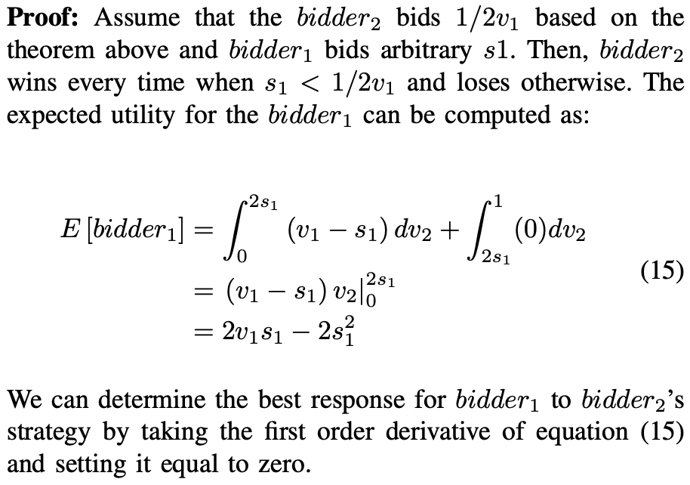
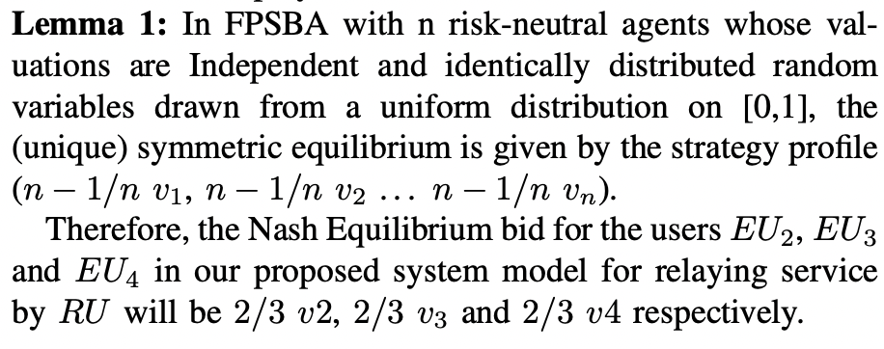
Computation of Bid – First Price Auction

Slide 15
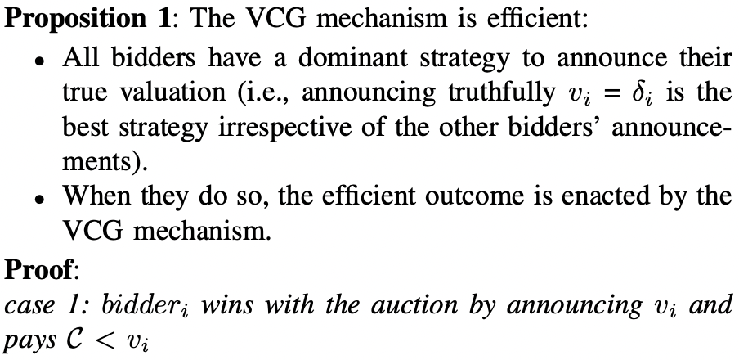
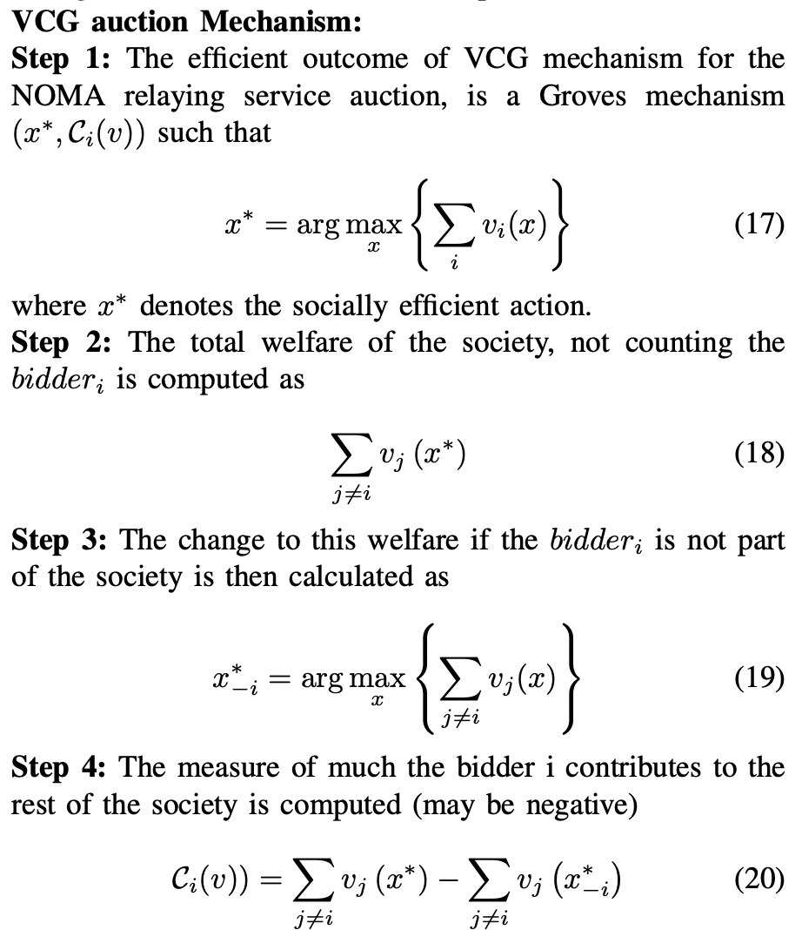
Computation of Bid – Second Bid Auction

Slide 16
VCG Auction
Step 1: The relay will choose to service all the three users as the combined bid is the highest (2+2.5+3) > (3+4) > 5.
Step 2: Cost for EU2:
The cost is computed ignoring EU2 = 3+4 = 7.
With EU2 in the society, the money from other users is 2.5+3=5.5.
The EU2 pays 7-5.5=1.5.
Similarly cost of EU3 and EU4 can be computed as 1 and 2.
Step 3: The RU provides retransmission for all the three users for prices $1.5, $1 and $2 respectively; earning a total of $4.5
For First Price Auction, the Nash Equilibrium solution is 2/3 vi. The winning bids would be 2/3 x 2 for EU2. 2/3 x 2.5 for EU3 and 2/3 x 3 for EU4. The total price paid by the users to obtain the same service using the first price auction would be $4.9999.

Slide 17
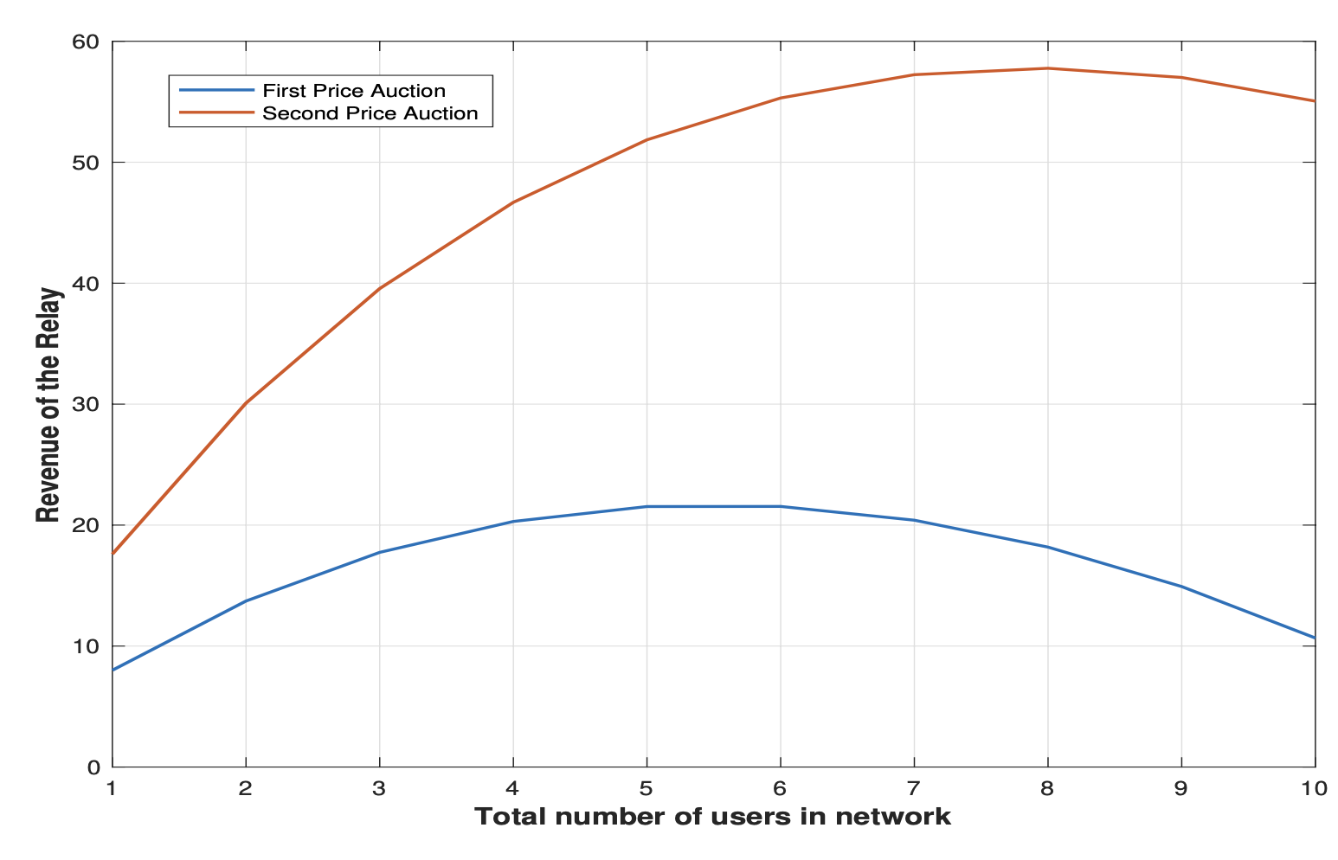
Simulations- Utility gain of user
The revenue of the relay is a concave function as expected with respect to the number of users supported in relay re-transmission as shown.
As the number of users increase, the interference increases, and the users do not make high bids. Therefore, the relay would be able to achieve optimal utility by choosing the right combination (subset) of users.
It can be noted that the second price VCG auction yields significantly better utility for the relay for any number of users supported.

Slide 18
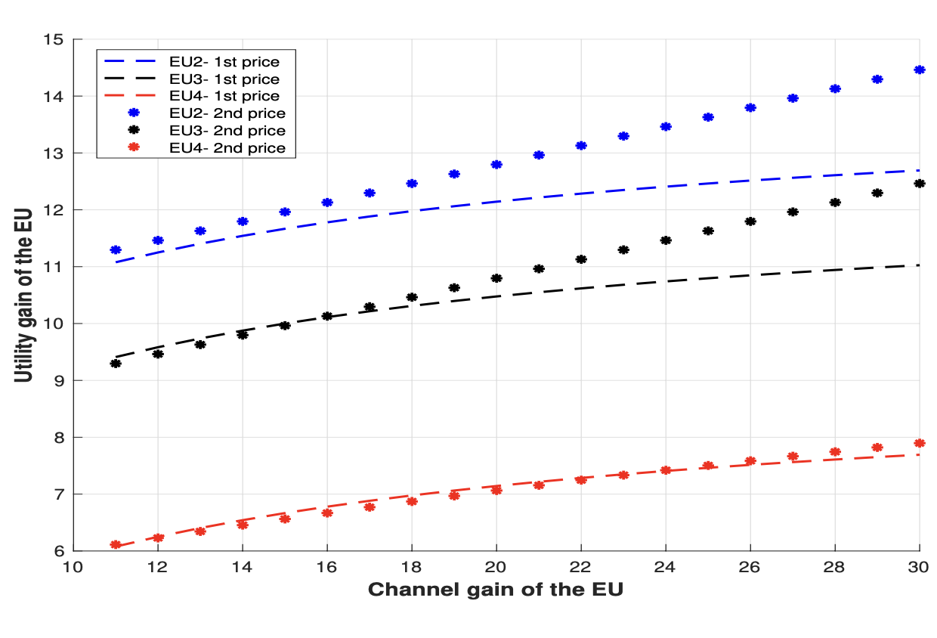
Simulations- Utility gain of end user
We evaluate the impacts of different channel gains on UEs′ SINR gain. In this simulation, we assume only the downlink channel RU is changing (i.e., RU moves towards the BS will cause the increase of |h1|2, while the environment among three E U s was kept stable (i.e., |h1,2 |, |h1,3 |, |h1,4 | remain unchanged).
From the figure, it can be observed that the second price approach (VCG) performs better as the channel gain increases across EUs .

Slide 19
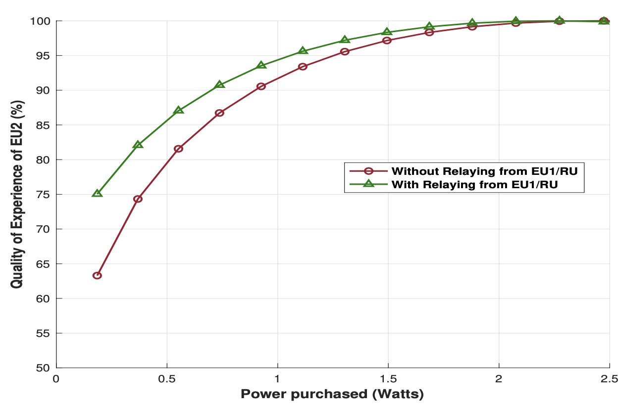
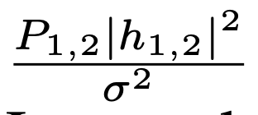
Simulations- Quality of Experience
Quality of Experience for EU2 with and without the extra retransmission from RU. QoE is a concave
function, and it can be visualized.
The retransmission adds term to the SINREU2 , further
boosting the QoE.
It can also be absorbed that the EUs′ participating in relay retransmission can achieve higher QoE at lower transmission power levels.

Slide 20
Conclusion
we propose a framework which takes advantage of the fact that a NOMA user with shorter distance naturally decodes the data packets of all users with longer distances.
Thus, NOMA relay has significant power saving potentials in comparison with direct retransmission from the base station.
Therefore, with proper incentive for transmission power, the short distance users (stronger EU) can act as relay in the NOMA network.
Two different auction techniques FPSBA and SPSBA (VCG) are leveraged to obtain the optimal solution for the proposed relay power auctioning approach.
The results indicate that all three parties: the base station, relay RU and end user EU benefit from the proposed scheme.
It was also observed that the VCG auction outperforms FPSBA in optimal network with good channel gain and minimal interference.

Slide 21
Thank you!
Q&A

